Slide 1


IST 652 Scripting for Data Analysis Final Project: Video Games Sales Analysis
Kobi Wiseman
July 2020

Slide 2
On The Agenda
Defining
Our business
problem
Describing
Statistics and data pre-processing
Running Models
Preparation, results and discussion

Slide 3
Our Business Problem
Lots of revenue potential, but due to game production costs – many risks
Aspects to be considered prior to production phase:
Location: Would any specific areas in the world be more profitable than others?
Platform: Could preferring a certain gaming platform over another be more lucrative?
Genre: Are there any game genres which provides higher revenue than others?
Do video games’ revenues change over time?

Slide 4
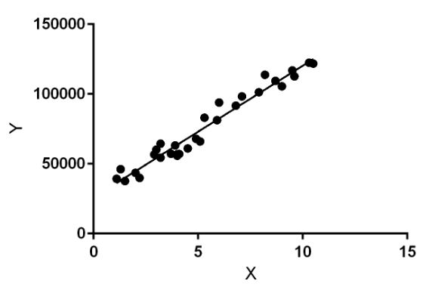
Models to Be Used
Linear Regression (Supervised)
K-means Cluster Analysis (Unsupervised)
Predicting the change of overall revenue
as a function of the entire data’s attributes
Classifying certain sub-groups within the data
with unique characteristics

Slide 5
Metadata
Feature | Type | Description
Rank | Integer | Ranking of overall sales
Name | String | Game’s title (table’s unique identifier)
Platform | String | Platform of the games on its release (i.e. PS4, PC etc.)
Year | Integer | Year of the game’s release
Genre | String | Genre related to the game (action, sports, strategy etc.)
Publisher | String | The company/studio to publish the game
NA_Sales | Float | Sales in North America (in millions of USD)
EU_Sales | Float | Sales in Europe (in millions of USD)
JP_Sales | Float | Sales in Japan (in millions of USD)
Other_Sales | Float | Sales in Other areas of the world (in millions of USD)
Global_Sales | Float | Overall sales in millions of USD (sum of areal sales above)

Slide 6
Cleaning The Data
Missing Values:
Feature | No. of missing values | Replacement
Year | 271 | The most frequent value: 2009
Publisher | 58 | ‘unknown’
Duplicate Rows:
No duplicate records were found.

Slide 7
Cleaning The Data
Extreme Values (Outliers):
Feature | Treatment
Year | The year information, even if considered as extreme, is true, and replacing it with any other measurement will make the results biased, therefore it will be retained.
NA_Sales, EU_Sales, JP_Sales, Other_Sales | Since the absolute revenues are directly related to the global sales, keeping it in that formant does not make sense. Thus, these variables are shifted to each area’s portion (in percentage) out of the global sales.
Global_Sales | The revenue information, even if considered as extreme, is valid, and replacing it with any other measurement will make the results biased, therefore it will be retained (for the cluster analysis, it will be binned into categories, so the magnitude of those values will be tremendously depressed).

Slide 8
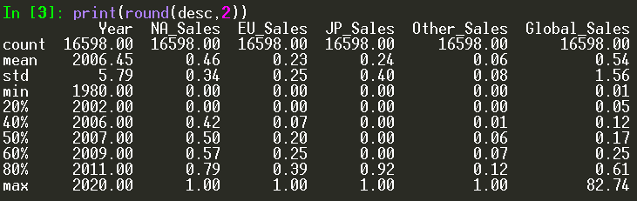
Exploratory Data Analysis
Numeric Attributes:
Having most of its data being on the low portions among overall revenues, ‘other sales’ has usually low influence compared to the defined other three regions
Video games range from 1980 to 2020
Japan and North America both reach high portion of the sales for certain franchises, which implies each one the areas enjoy a separate market share

Slide 9
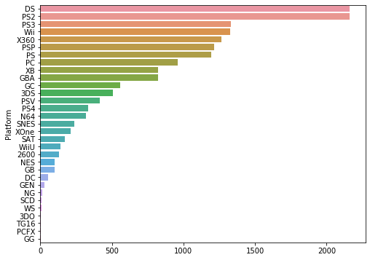
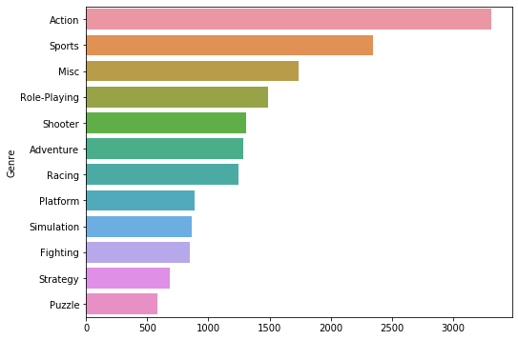
Exploratory Data Analysis
Categorical Attributes:
Nintendo DS and PlayStation 2 are by far the most common consoles in the past
40 years. Far from those, but with noticeable presence, we observe PlayStation 3,
Nintendo Wii, Xbox 360, PSP and PS with roughly 1200-1300 games each. PC, which at the far past used to be only source for gaming, is behind all the above, with less than 1000 games within the data.
Platform
Action and sports games are the most common genres among the best-sellers during the last 40 years. Strategy and puzzles are the least frequent with only a little more than 500 games each.
Genre

Slide 10
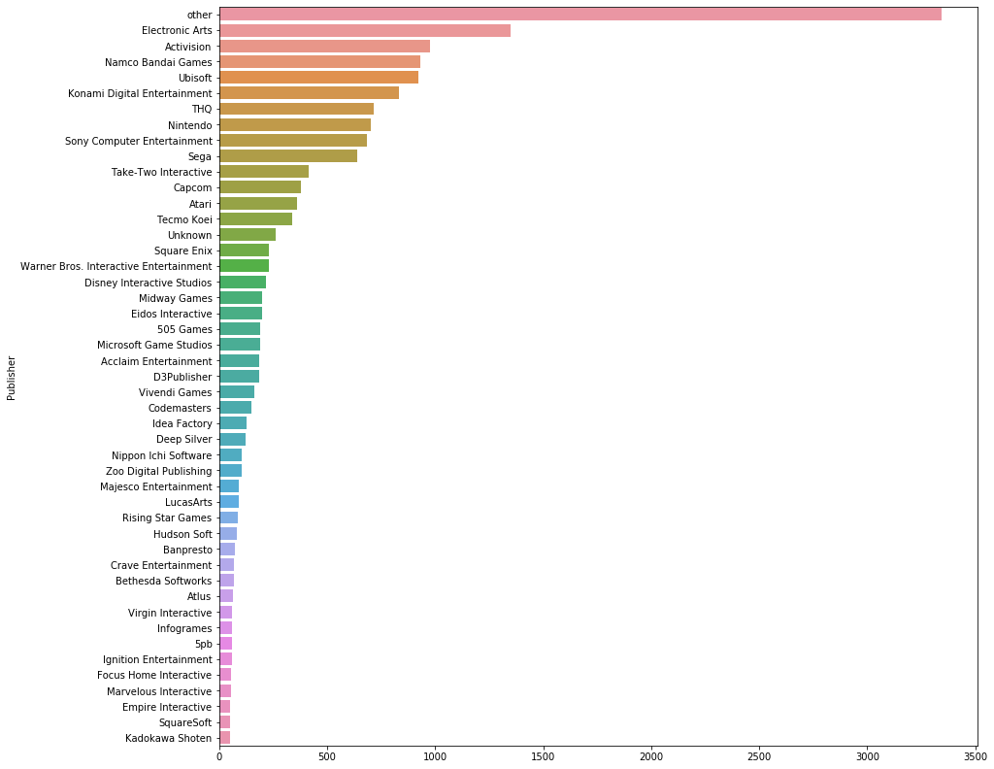
Exploratory Data Analysis
Categorical Attributes:
The 'other' category which covers all the video games studios with less than 50 games each, reaches over 3,000 games overall. Electronic Arts is the leading publisher with roughly 1,500 games, followed by Activision, Namco and Ubisoft with about 1,000 games each.
Publisher

Slide 11
Linear Regression Model Data Preprocessing
Steps to be made prior to running the model
Dummies for categorical attributes
VGLinFin = pd.get_dummies(VGLin, columns=['Platform', 'Genre', 'Publisher'],drop_first=True)
Checking Multicollinearity (using Correlation Matrix)
VGCorr = VGLinFin.corr()
Dropping irrelevant attributes for this model (‘Name’)
Splitting data into 70/30 test/train sets
from sklearn.model_selection import train_test_split
X_train, X_test, y_train, y_test = train_test_split(X, Y, test_size=0.3, random_state=0)
Publisher

Slide 12
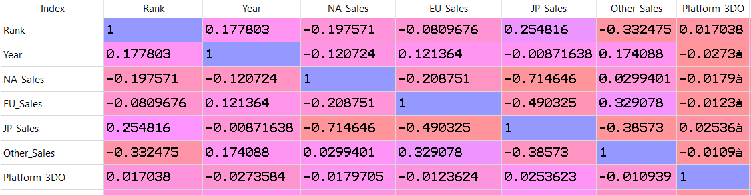
Linear Regression Model Data Preprocessing
Correlation Matrix Results (part of the matrix is shown):
High correlations were found, between JP_Sales and NA_Sales (-0.71) and between JP_Sales and EU_Sales (-0.49).
Since the correlation between NA_Sales and EU_Sales is not very high (-0.21), only JP_Sales will be dropped before running the model.

Slide 13
Linear Regression Model Data Preprocessing
Correlation Matrix Results (part of the matrix is shown):
High correlations were found, between JP_Sales and NA_Sales (-0.71) and between JP_Sales and EU_Sales (-0.49).
Since the correlation between NA_Sales and EU_Sales is not very high (-0.21), only JP_Sales will be dropped before running the model.

Slide 14
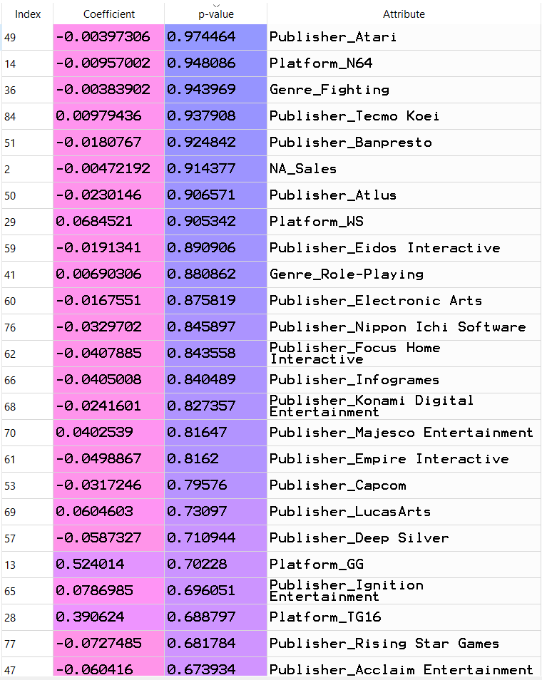
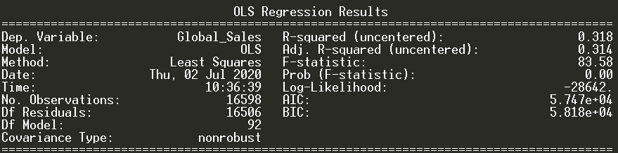
Linear Regression Model First Running
Model is significant (P(F)<0.05)
Adjusted R-squared: 0.31
MSE: 155.2
However, lots of insignificant coefficients (as seen on the left)
Dropping all those coefficients which are greater than 0.05

Slide 15
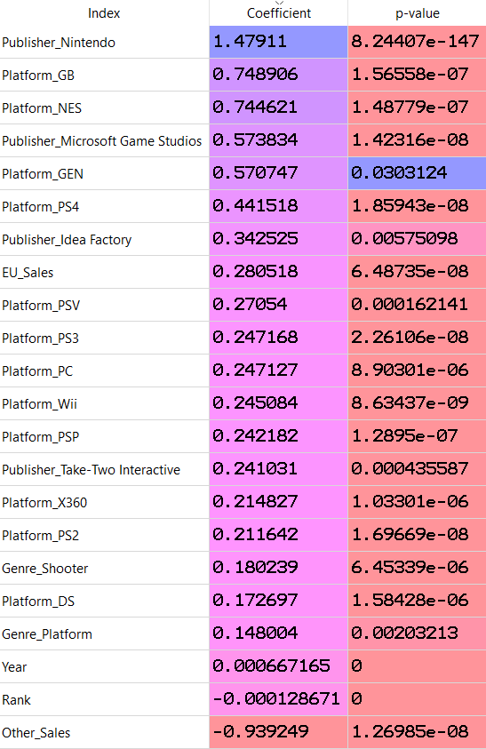
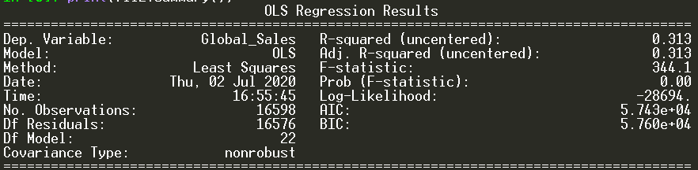
Linear Regression Model Second Running
Model is significant (P(F)<0.05)
Adjusted R-squared remains the same: 0.31
MSE has increased to 640.2
However, the model now has only significant coefficient
Business-wise it is easier to interpret and to implement

Slide 16
Linear Regression Model Business interpretation highlights
Publishing a game with Nintendo is predicted to gain $905,276 more revenue than Microsoft Game Studios.
Developing a game based on the PlayStation 4 console is predicted to provide $194,391 more revenue than a PC game, and $196,434 more than a game designed for the Wii platform.
Each increase of one percent of other areas sale’s portion out of total sales is predicted to decrease the overall revenue by $939,249.

Slide 17
K-means Cluster Analysis Data Preprocessing
Steps to be made prior to running the model
All numeric attributes have been binned into 10 equal-intervals bins
Using Panda’s cut() function
‘Rank’ and ‘Global_Score’ have the same meaning when binned by ordering their size, therefore only ‘Rank’ will remain
In addition to ‘Name’, ‘Publisher’ is also a string attribute which contains too many distinct values with no clever way to divide into groups. Therefore, it will be dropped as well.
‘Platform’ and ‘Genre’ have been adapted by ‘business-tailor’ binning:
specific dummy and categorical variables were created for Nintendo / PlayStation / Xbox / PC consoles,
While ‘Genre’ is divided by ‘Adrenaline’ games (action, fighting, sports, adventure, platform, racing, shooter) and ‘Strategy’ games (Puzzle, Role-Playing, Simulation and Strategy).

Slide 18
K-means Cluster Analysis How Many Clusters?
Initial Principal Component Analysis (PCA) was conducted in order to extract Eigenvalue:
from sklearn.decomposition import PCA
pca = PCA(n_components=5)
print(pca.explained_variance_)
5th value goes below 1,
Thus 4 is the appropriate number of factors
(clusters)

Slide 19
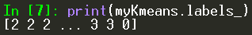
K-means Cluster Analysis Running The Model
Uploading the KMeans package:
from sklearn.cluster import Kmeans
Running the model with 4 clusters:
myKmeans = KMeans(n_clusters=4).fit(KdataFin)
The ‘labels’ component contains a series with all the corresponding cluster numbers for each row:
print(myKmeans.labels_)
Storing this series as an object:
clusternum = myKmeans.labels_
Adding 1 to each cluster number, so labels will be 1 to 4 instead of 0 to 3:
clusternum = clusternum+1
Storing this series as a one-column dataframe:
clusternum = pd.DataFrame(clusternum, columns=['cluster’])
Finally, attaching this new ‘dataframe’ into the model-used dataframe:
KdataClust = pd.concat([KdataFin, clusternum], axis=1, sort=False)

Slide 20
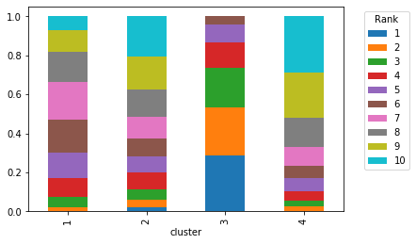
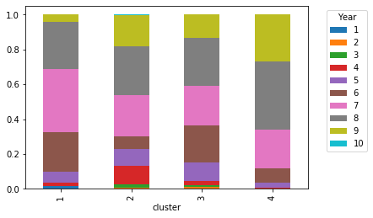
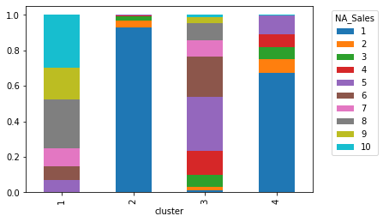
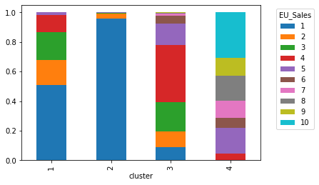
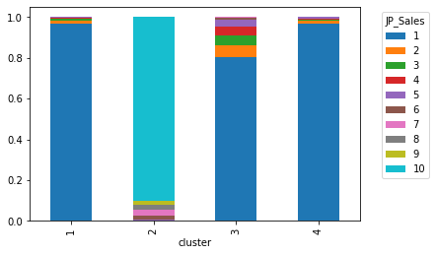
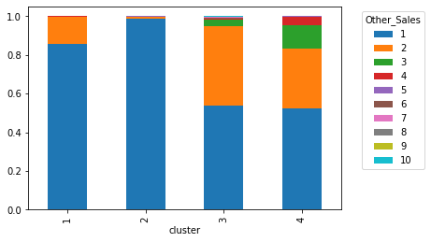
K-means Cluster Analysis Visualizations

Slide 21
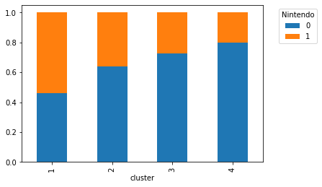
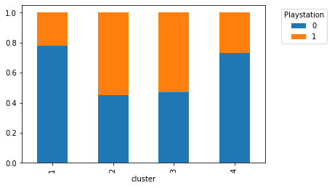
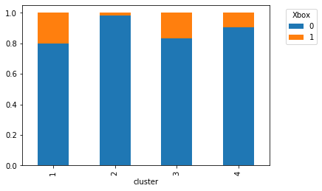
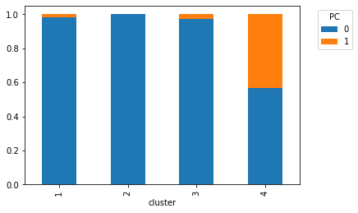
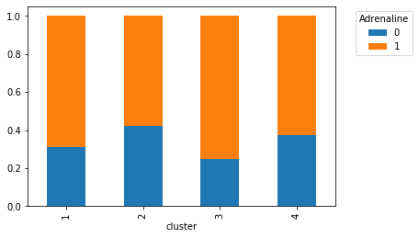
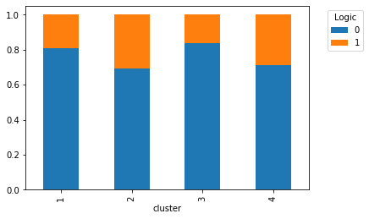
K-means Cluster Analysis Visualizations

Slide 22


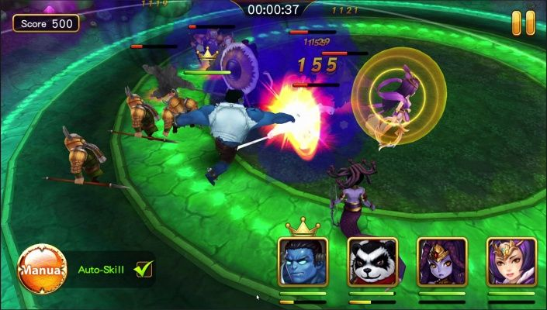







K-means Cluster Analysis Model Interpretation
Cluster #1:
Cluster #2:
Medium sales
Last decade
PlayStation platform
‘Adrenaline’ games
Japan region
PlayStation platform
‘Logic’ games
Cluster #3:
Cluster #4:
Top-sellers
Years between 2000-2010
North America Region
Nintendo Console
‘Adrenaline’ games
Low level revenues
Last decade
Europe Region
PC

Slide 23

Thank you!

